Slide 1
PRESENTATION ON PROJECT REPORT
SUB Course Registration Form
Supervised by:
Khan Md. Hasib
Lecturer, Presented by:
CSE Department. Taskir Rahman Tasin
State University of Bangladesh UG02-48-18-007

Slide 2
Contents
1.Introduction of topic
2.Feasibility Analysis
3. Minimum Requirement
4.Index Terms
5.System Design
6.Output
7.Future plan

Slide 3
Introduction of Topic
Student course registration are a vital part of any university’s. A poor course registration system can mean fever student being take course in a new semester because of mistake or an overly slow response time.
Student course registration is the project which is helpful for student and as the department . In this project the student facilitated by taking courses, implement their installment payment information and input their personal information.
Through this system we overcome many problems.
1.Time and money saved.
2.Nothing to done manually.

Slide 4
Feasibility Analysis
This project system was developed where a student can register himself. The registration form has been designed to be user friendly and easy to fill by the students. The project can be undertaken with available technology and resources.

Slide 5
Minimum Requirement
Hardware Requirements:
Pentium-III Processor with 512 MB RAM
Screen resolution viewing of at least 800*600 is required for proper and complete viewing of screens. Higher resolution will be accepted.
Software Requirements:
Operating system:- Windows XP/7/8.1/10
Application Software:- XAMPP, notepad++

Slide 6
Index Terms
MySQL: MySQL is a RDBMS based on SQL which is used for adding, removing and modifying information in the database.
RDBMS: Relational Database Management System
HTML: Hypertext Markup Language is use to create interface element.
PHP: Hypertext Preprocessor
CSS: Cascading Style Sheet

Slide 7
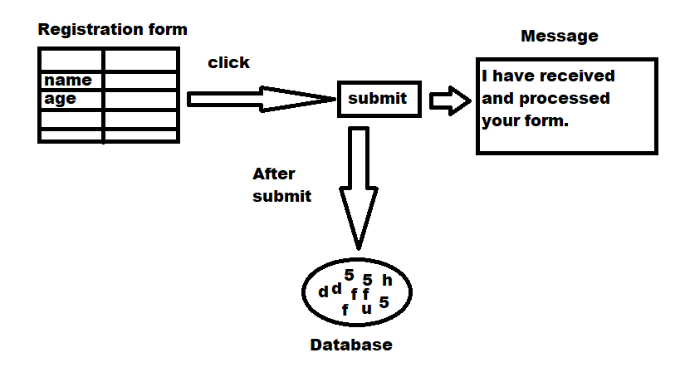
System Design

Slide 8
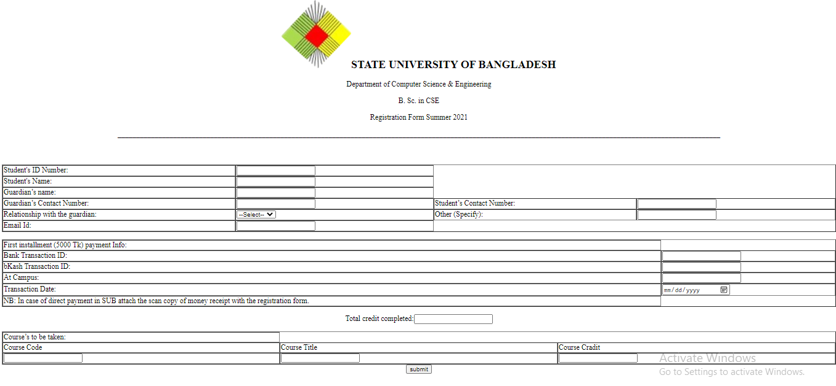
Output

Slide 9
Conclusion
This project was developed keeping in mind the functionalities for students and advisors. This project provides all the functionalities specified in the project document. I tried to simulate the real world environment by generating loads of data from the university itself. Much functionalities can be added over the existing one so that the system has more enhanced features and its more efficient.

Slide 10
Future plan
Added a login interface for students and advisor and a option for advisor to see who submitted registration form.

Slide 11
Thank you

